Slide 1

Welcome to the Presentation on UI/UX Insider Tips!
I’m excited to have you here as we dive into the world of User Interface (UI) and User Experience (UX) design. In this presentation, we will explore invaluable insider tips that will elevate your UI/UX journey.

Slide 2
Enhance your Design creativity through Gaming experience
The Boolean game
01
What is the hex.
02
The Bezier game
03
04
CAN’T
UNSEE

Slide 3

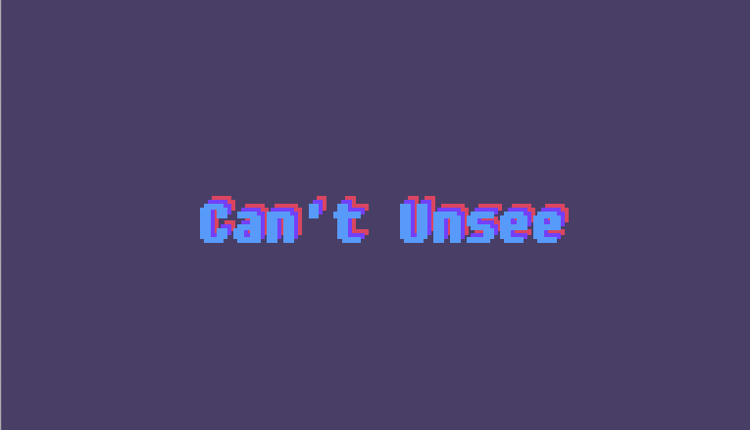
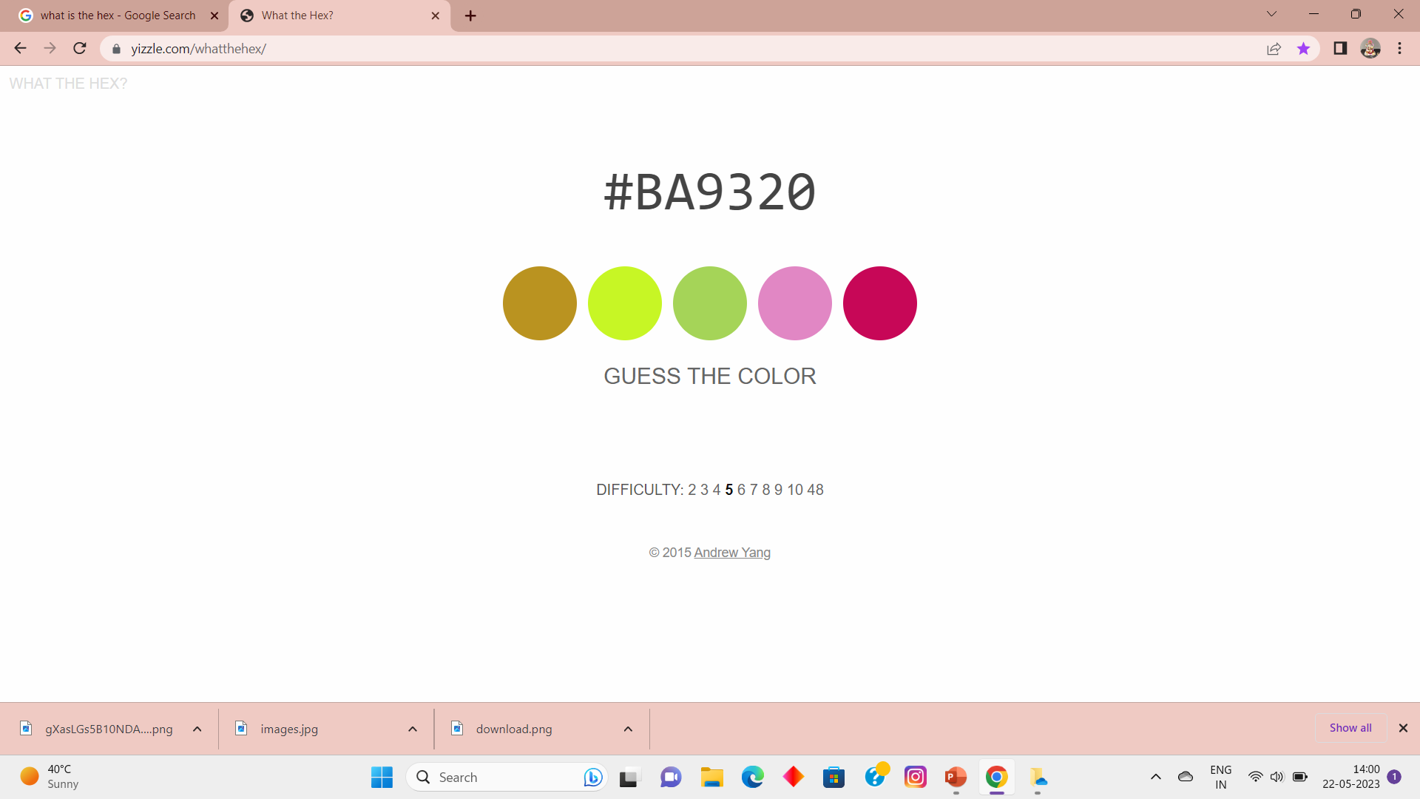
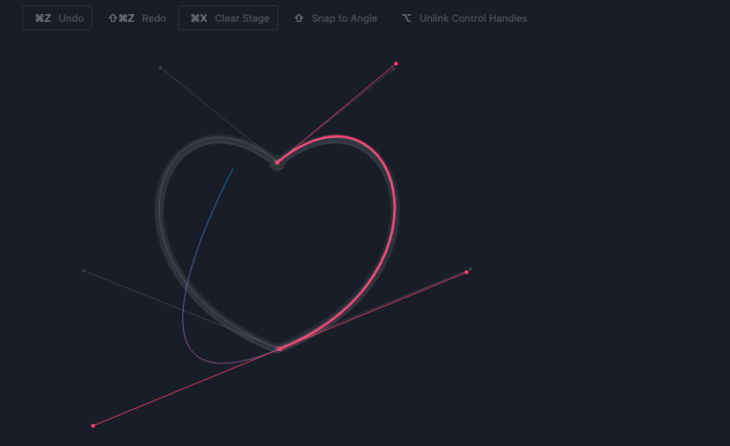
01
02
03
04

Slide 4
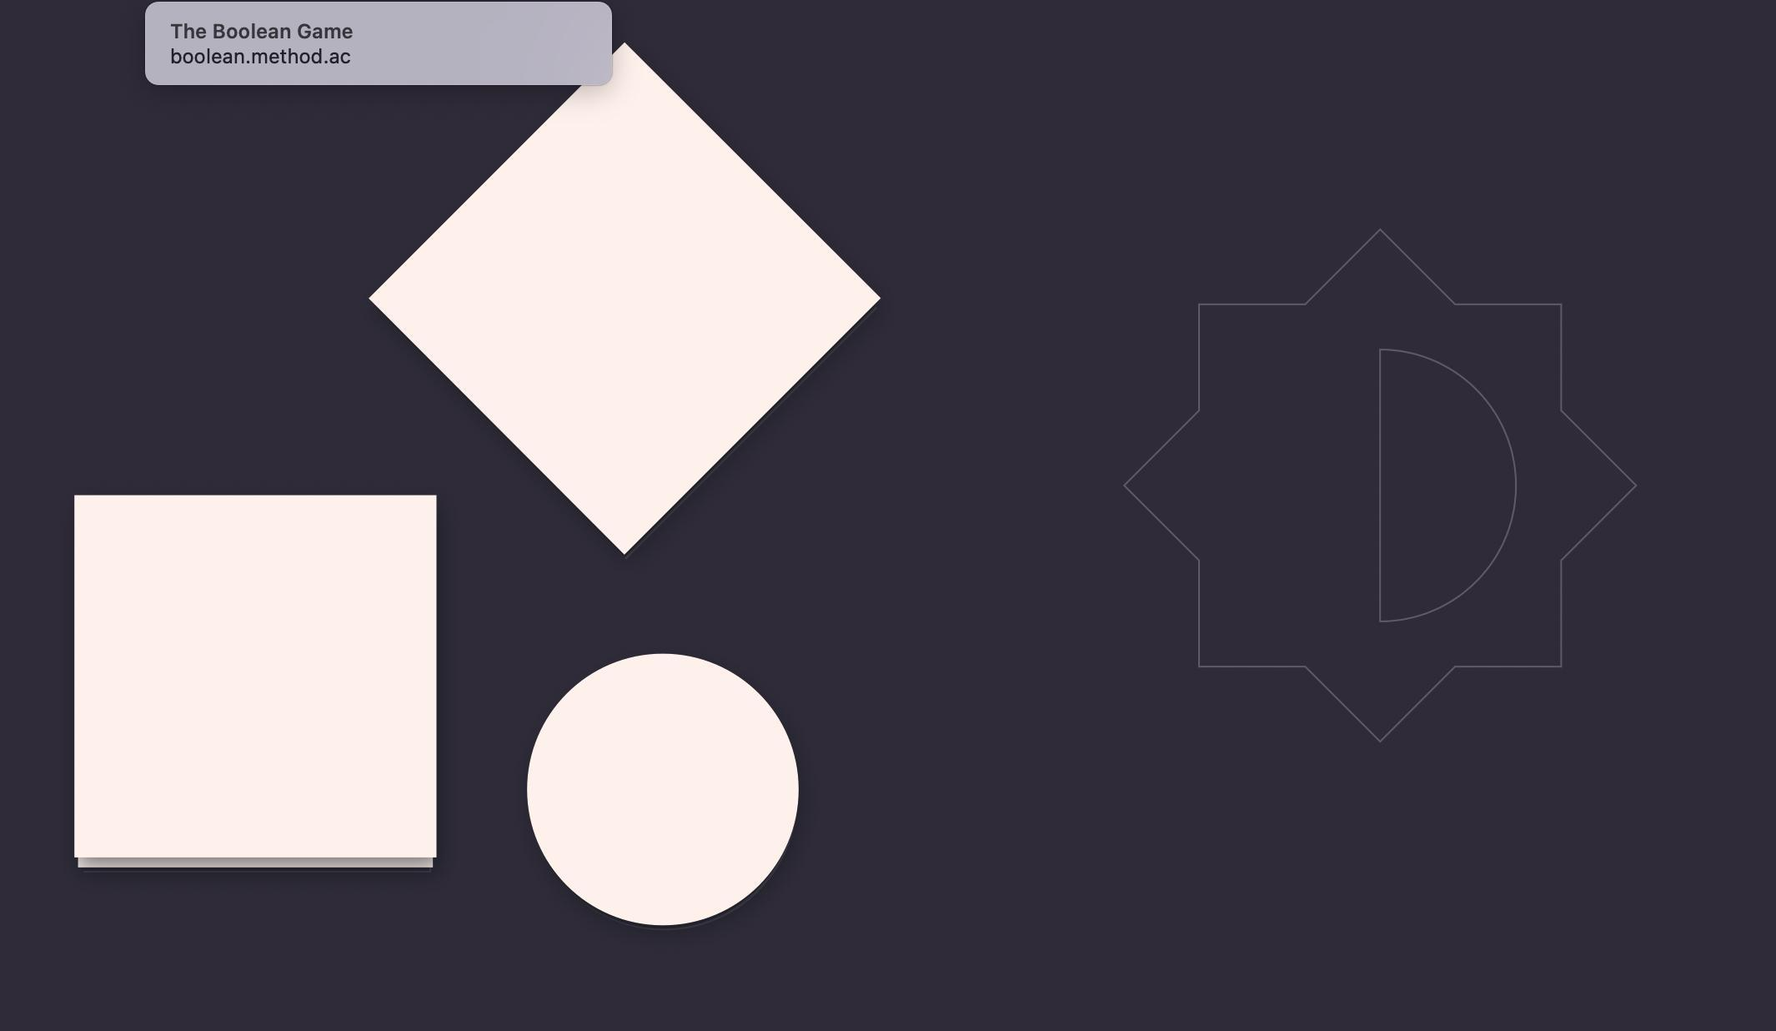
01
The Boolean game

Slide 5


01
The Boolean game
Abstract Boolean games are a framework for reasoning about the rational behavior of agents whose goals are formalized using propositional formulas. Compared. to normal form games, a well-studied and related game framework, Boolean games. allow for an intuitive and more compact representation of the agents' goals.

Slide 6
01
The Boolean game

Slide 7


02
WHAT IS THE HEX

Slide 8

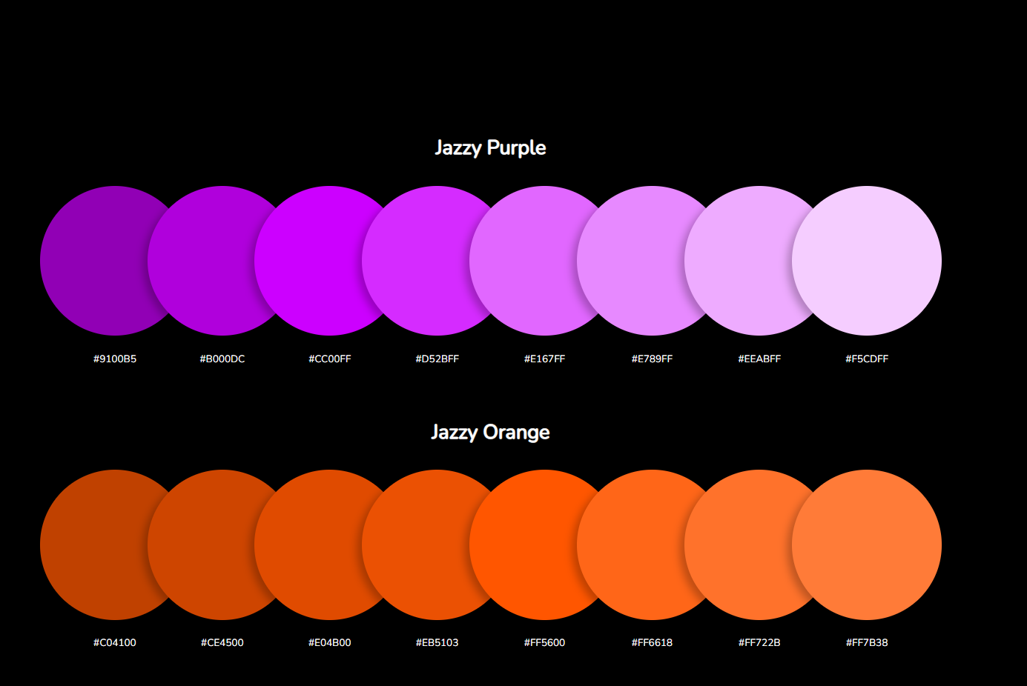
02
WHAT IS THE HEX

Slide 9
02
WHAT IS THE HEX
Hex Color game is a unique idle game in which you must work to develop a range of hexadecimal colors. With over 16,000 different colors to make this game has endless possibilities and will keep you entertained for hours.

Slide 10

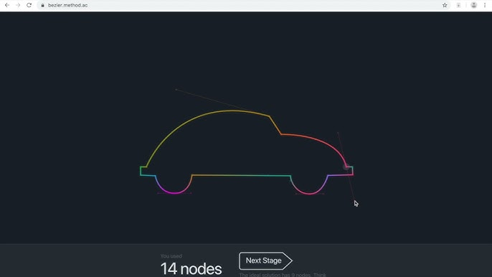
03
The Bezier game

Slide 11


The Bezier game

Slide 12

The Bézier Game refers to the Bézier curve, a parametric curve used in computer graphics and programs such as Photoshop and Illustrator. A set of discrete “control points” defines a smooth, continuous curve by means of a formula.
03
The Bezier game

Slide 13
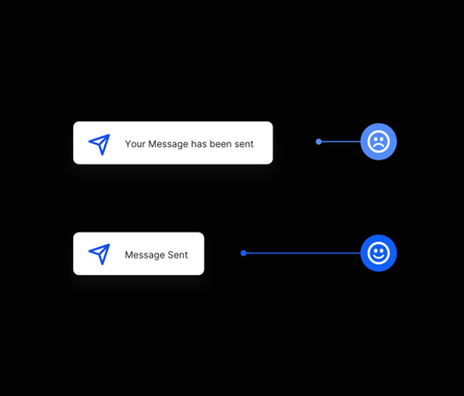
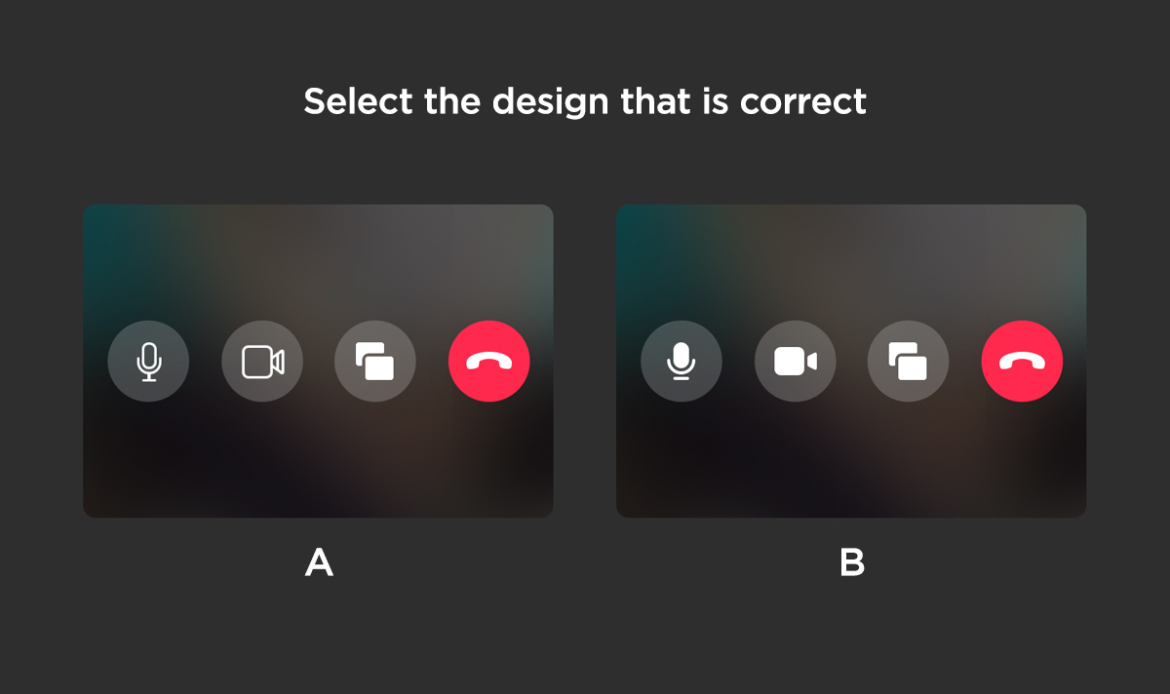
04
CAN’T UNSEE
Can't Unsee is a game designed to sharpen your attention to detail and creativity. The goal of the game is to identify which design elements of two near-identical objects are different.

Slide 14
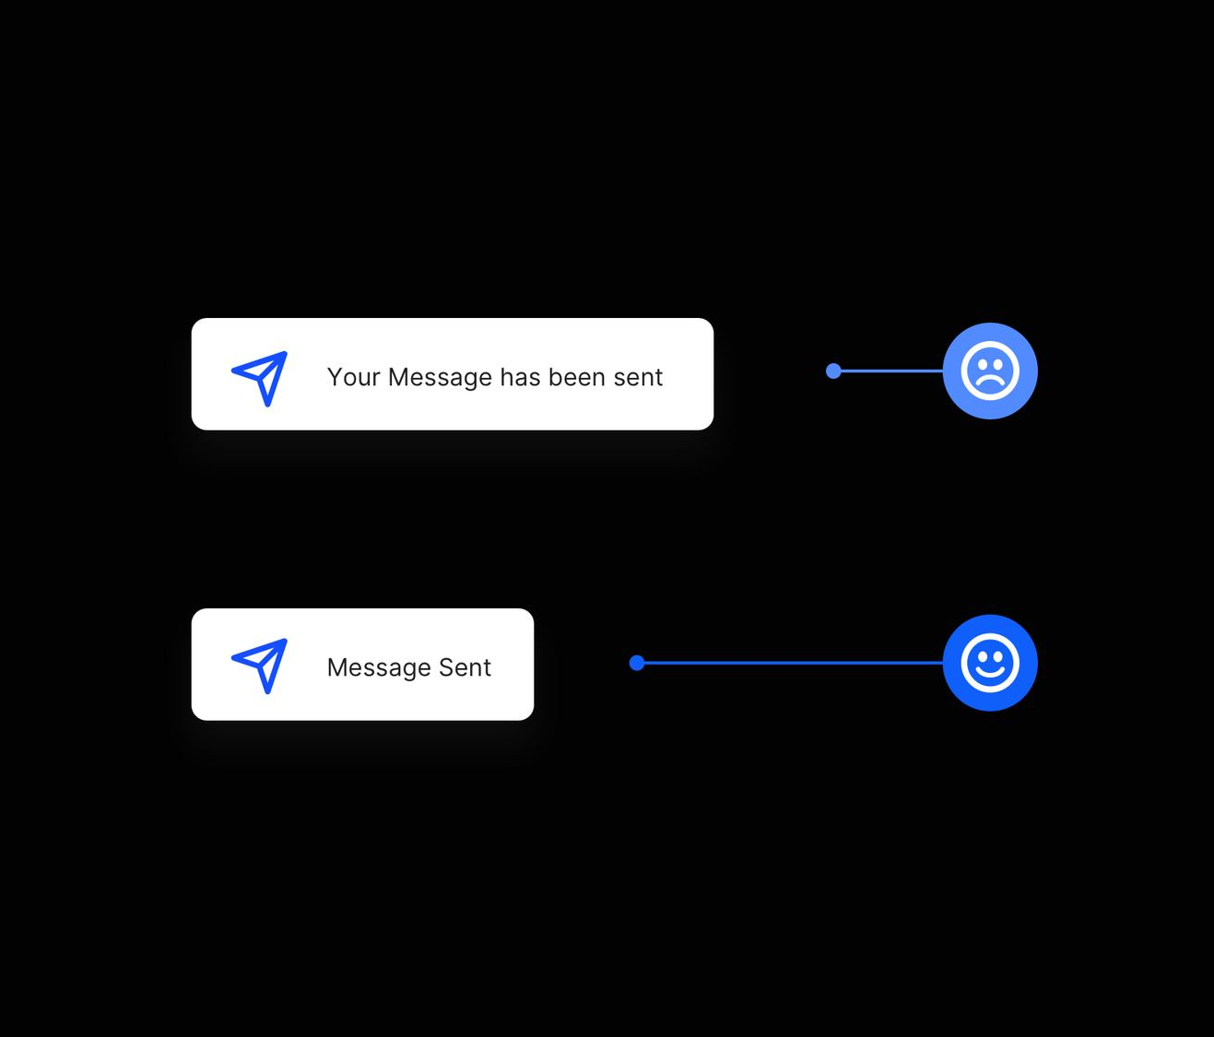
04
CAN’T UNSEE

Slide 15
04
CAN’T UNSEE

Slide 16
Janhawi Paswan
@genialjam
Thank you for taking the time to read.
If you liked this, follow me for more.
Sincerely yours, Janhawi Paswan.

